Slide 1
Career Development Training Course
The Foundation of
Career Counseling

Slide 2
CDTC Mission Statement
To provide Career Development Team (CDT) members with the foundational knowledge and skills required to execute an effective Career Development Program (CDP).
Notes:
FACILITATOR GUIDE:
None.

Slide 3
Class Introductions
Facilitator Introductions
Counselors Introductions
Create list of Classroom “norms”
Notes:
FACILITATOR GUIDE:
Use this time to conduct class norms and introductions.

Slide 4
Career Development Training Course
Career Development Program

Slide 5
Enabling Objectives
STATE the purpose of a Career Development Program (CDP)
STATE the purpose of OPNAVINST 1040.11 (series)
STATE the purpose of NAVPERS 15878 (series)
DISCUSS key elements of the Career Information Program Review (CIPR) checklist and Department counselor review
Notes:
FACILITATOR GUIDE:
Review objectives
Focus of this training topic should be geared towards building level of knowledge in our newly identified counselors “to be” with emphasis on their role in management of CDP.
Printouts of CIPR and an example of an POA&M can be utilized as handouts for this lesson.

Slide 6
References
Navy Enlisted Retention and Career Development Program, OPNAVINST 1040.11 (series)
Bureau of Naval Personnel Career Counselor Handbook, NAVPERS 15878 (series)
Career Information Program Review, NAVPERS 1040/2
Command Career Counselor Personnel Qualification Standard (PQS) NAVEDTRA 43699 (series)
Notes:
FACILITATOR GUIDE:
Review references

Slide 7
Purpose of Career Development Program (CDP)
The CDP is designed to enhance the ability of Sailors to achieve their professional goals and to positively impact their desire to remain on active duty or transition to the Navy Reserves
Active LEADERSHIP involvement, from across all spectrums is required for a successful CDP
The PILLAR of a successful CDP is a knowledgeable and effective Career Development Team (CDT)
Notes:
FACILITATOR GUIDE:
Key efficiency and effectiveness of CDT members in management of CDP are measured with CIPR checklist and later expounded upon in this lesson.

Slide 8
OPNAVINST 1040.11 (series) PURPOSE
Navy Enlisted Retention and Career Development Program governing instructions
Discuss management and operation of the Navy Enlisted Retention and Career Development Program
Lists the level of hierarchy and responsibilities associated to each role
Notes:
FACILITATOR GUIDE:
Primary Instruction That Governs What We Do!
Provides guidance and delineates the duties and responsibilities of each stakeholders that are charged with management of the CDP.
All CDT members MUST ADHERE to this policy!

Slide 9
NAVPERS 15878 (series)
PURPOSE
Bureau of Naval Personnel Career Counselor Handbook.
Serves as the "how-to" guide in the implementation and management of the Career Development Program.
A vital resource for your toolbox.
Lists web-based applications required in execution of the CDP and how to gain access.
Contains screen shot tutorials on each web-based application for functionality and familiarization.
Notes:
FACILITATOR GUIDE:
A great resource to have in your toolbox. It goes into details that the OPNAVINST 1040 series may not cover as it relates to supporting functions of a career counselors i.e. Transition requirements and familiarization with DMDC website, most common items of interest from Sailors along with associated forms etc. When sufficient hands-on OJT is not attainable, this resource is available to aid counselors in their familiarization and execution of duties. Keep in mind that all personnel issues and procedures are governed by an MILPERSMAN article i.e. reenlistment, CWAY, separations etc. and will be expounded upon later in this training.

Slide 10
Career Information Program Review (CIPR) NAVPERS 1040/2
Primary resource utilized to assess the effectiveness of a command’s CDP.
Commands must be evaluated on a fiscal year basis by a higher echelon.
Can be referenced when being considered for Retention Excellence Award (REA) and Career Counselor of the Year (CCOY).
Command Career Counselors must conduct a self-assessment utilizing NAVPERS 1040/2 within 90 days of reporting and provide results to their CO via XO and CMC.
Schedule assist visits with Immediate Superior in Command (ISIC) as needed.
Notes:
FACILITATOR GUIDE:
In addition to above, self-assessment can be conducted locally during turnover of duties between DEPT/DIV CC’s and retain with CCC. Always refer to latest NAVADMIN and message from TYCOM as it relates to REA and CCOY requirements.

Slide 11

CIPR NAVPERS 1040/2 cont...
CIPR consists of 11 critical career development pillars that are identified by an exclamation point found on the CIPR guide located on the MyNavyHR website.
The CIPR will receive overall grade mark of compliant, partially compliant, or non-compliant:
  COMPLIANT: When 10+ pillars are met along with 30-33 standard line items
  PARTIALLY COMPLIANT: When 9 pillars are met along with 27-29 standard line items
  NON-COMPLIANT: When 8 or less pillars are met, along with 26 or less standard line items
Notes:
FACILITATOR GUIDE:
Communicate with your Triad to determine an inspection date that works best with the command’s schedule
Coordinate availability with your ISIC/TYCOM to confirm an inspection date
Schedule an in-brief and debrief for your triad
Complete a self-assessment and forward a copy to your inspector at least 14 days prior to scheduled CIPR date

Slide 12


CIPR NAVPERS 1040/2 cont...
 | Section A |  |  | Section B |  |  | Section D |  |  | Section E |  |  | Section F
 | CDP MANAGEMENT |  |  | CDT |  |  | CDBs |  |  | PACT |  |  | CWAY-REEN
 | A1 | Triad Communication |  | B1 | Quarterly Meetings |  | D1 | CMC CDB Chair |  | E1 | PACT Qualifications |  | F1 | CWAY Submissions
 | A2 | CCC Office Space |  | B2d | Trained CC Ratio |  | D2 | ICDP Development |  | E1a | PACT Submissions |  | F2 | CWAY Reviews
 | A3 | ISIC/Region Training |  | B3 | Dept CC Designation |  | D3 | Career Decisions |  | E2a | 6-Month PACT CDBs |  | F3 | CWAY Notes
 | A4a | BOL Access |  | B4 | Monthly CCC Training |  | D4a | Reporting CDBs |  | E2b | 12-Month PACT CDBs |  | F4 | CWAY Page 13s
 | A4b | CIMS Access |  | B5 | Annual Dept Review |  | D4b | CWAY CDBs |  | E2c | 18-Month PACT CDBs |  | 1 Pillar + 3 Standard Line Items
 | A4c | CIMS Afloat Access |  | 2 Pillars + 3 Standard Line Items |  |  | D4c | Separation CDBs |  | E3 | PACT 24-Month Report
 | A4d | CWAY Access |  |  |  |  | D4d | 24-Month CDBs |  | E3a | 24-Month Documentation
 | A4e | MyNavy Assignment |  | Section C |  |  | D4e | 48-Month CDBs |  | 2 Pillars + 5 Standard Line Items |  |  | Section G
 | A4f | NRMS Access |  | CDT TRAINING |  |  | D4f | 60-Month CDBs |  |  |  |  | TAP
 | A4g | OMPF Access |  |  |  |  | 1 Pillar + 8 Standard Line Items
 | A4h | DMDC Access |  | C1 | CDTC |  |  |  |  |  |  |  | G1 | VOW Compliance
 | A4i | FLTMPS Access |  | C2 | FTSW |  |  |  |  |  |  |  | G2 | DD-2648 Completion
 | A5 | BBD System Access |  | 2 Standard Line Items |  |  |  |  |  |  |  |  | G3 | CTO/Command designation
 | A6 | Monthly Reports |  |  |  |  | Critical CDP Pillar Line Items |  |  |  |  |  | 1 Pillar + 2 Standard Line Items
 | 4 Pillars + 10 Standard Line Items
Compliant: 10+ critical pillars are met AND 30-33 standard line items are graded as “Effective” or N/A
Partially Compliant: 9 Pillars are met AND 27-29 Standard Line items are graded as “Effective” or N/A
Non-Compliant: 8 or less Pillars are met AND/OR less than 26 Standard Line items are graded as “Effective” or N/A
Notes:
FACILITATOR GUIDE:
Screen shot of standard line items with critical pillars identified. Emphasis and due diligence is required in the management of critical pillars.

Slide 13
CIPR NAVPERS 1040/2 cont...
A Plan of Action and Milestone (POA&M) report must be generated for line items marked as “partially effective” or "ineffective"
POA&M will be completed and forwarded to ISIC within 30 calendar days of CIPR
The CCC alone should not be the action person
Ensure each stakeholder (designated person) takes ownership of their portion
The CDT must work together in keeping CDP online and effective
Notes:
FACILITATOR GUIDE:
Having full support from TRIAD and remaining CDT will result in a successful review. Preparation ahead of time is key. Do not hesitate in requesting an ISIC CIPR site visit at least 90 days prior to official review and be sure to conduct an honest self-assessment prior to ISIC visit.

Slide 14
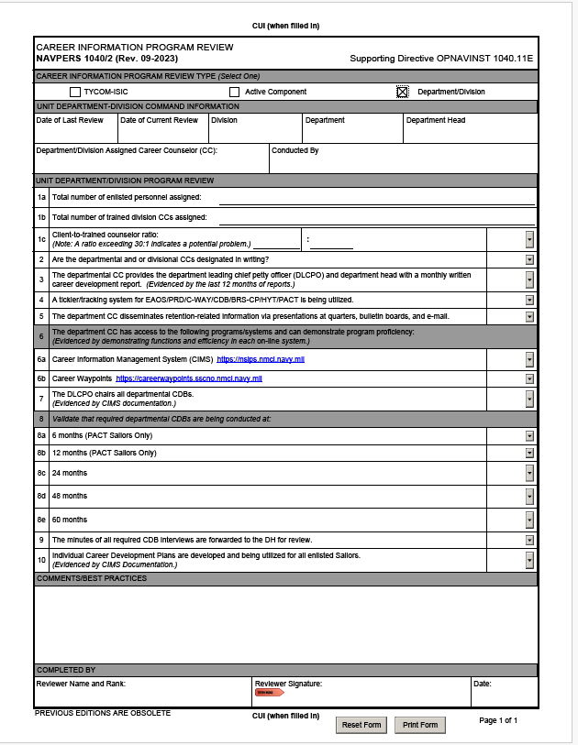
Department/Division CIPR
SAMPLE
Notes:
FACILITATOR GUIDE:
It is the responsibility of the CCC to conduct this assessment of their DEPT CC prior to ISIC/TYCOM overall assessment of CDP. Having access to all IP services to perform duties will be granted after CDTC is complete and designated in writing by the CO. A POA&M must be generated to address areas of concern.

Slide 15
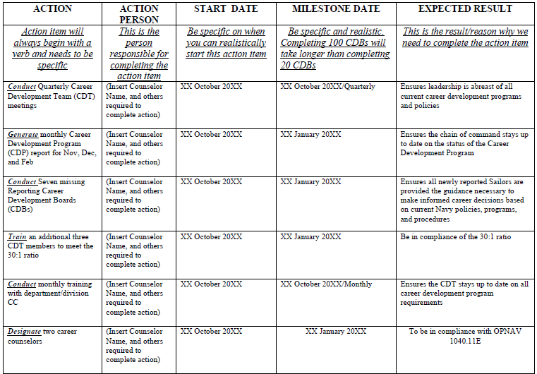
POA&M Example
Notes:
FACILITATOR GUIDE:
None.

Slide 16
Summary and Review
In this lesson we discussed:
  OPNAV 1040.11 (series) and how it is your governing instruction
  CCC Handbook and how it is a vital resource for your toolbox
  Utilization of the CIPR checklist to conduct a self-assessment in determining the health of the CDP
  Preparing and executing a POA&M as required
  Keeping your CDT informed and updated on CDP matters
  To never hesitate to communicate with your CCC and/or ISIC
Notes:
FACILITATOR GUIDE:
This is an opportunity for you to discuss “share best practices” that are unique to your cognizant relating to the effective management of CDP.

Slide 17

Career Development Program

